Slide 1
Monolithic Vs Microservices
Comparing Architecture Styles

Slide 2
"Have you ever wondered what happens when you visit a website?"

Slide 3

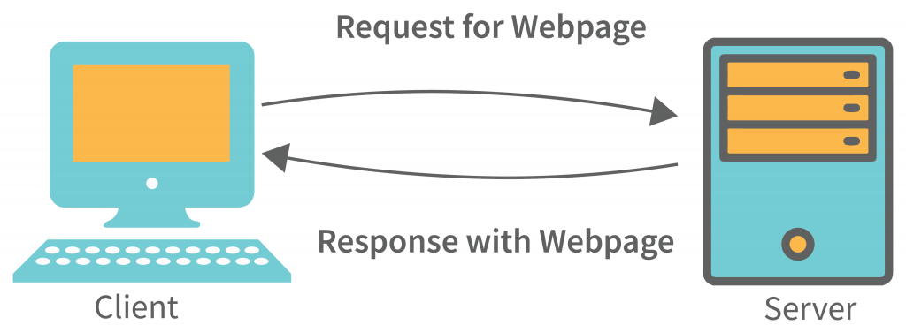
Client-Server Architecture

Slide 4
Search About That, you get
Response
Request
Browser
Client
REST API
HTTP
Server
Database

Slide 5
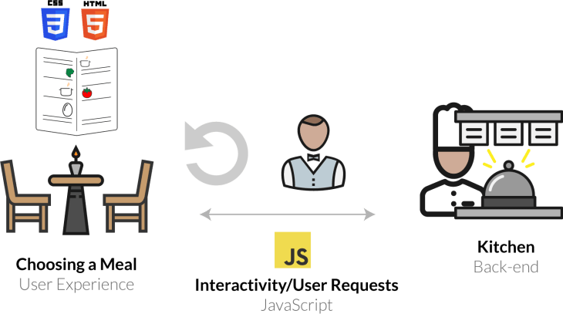
Let’s Understand Using Analogy

Slide 6
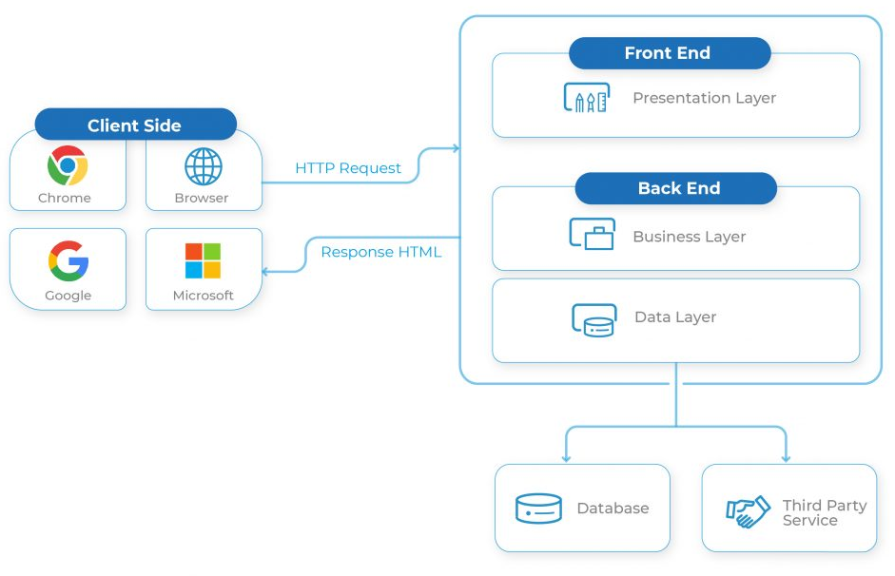
Components of Web Application

Slide 7
Architecture of Web Application
Web application architecture refers to the structural design and organization of a web application, defining how various components and modules interact with each other to deliver the intended functionality.

Slide 8
Architecture of Application
Monolithic Architecture
Microservices Architecture
Serverless Architecture
Headless Architecture
N-Tier Architecture
Model-View-Controller-Architecture
Progressive Web Apps
Service Oriented Architecture (SOA)
Event-Driven Architecture
Containerized Architecture
Hexagonal Architecture (Ports and Adapters)

Slide 9
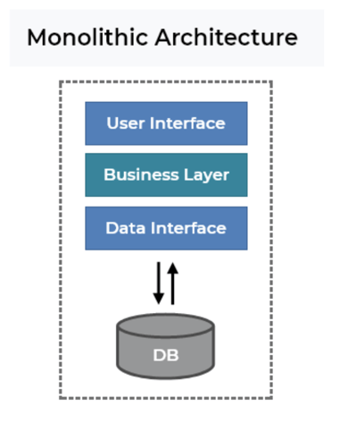
Microservices Architecture
Most traditional and straight forward approach
Packaged together as single unit
Tightly coupled
Single codebase written in one programming language
Easier Development, Debugging, and Deployment

Slide 10
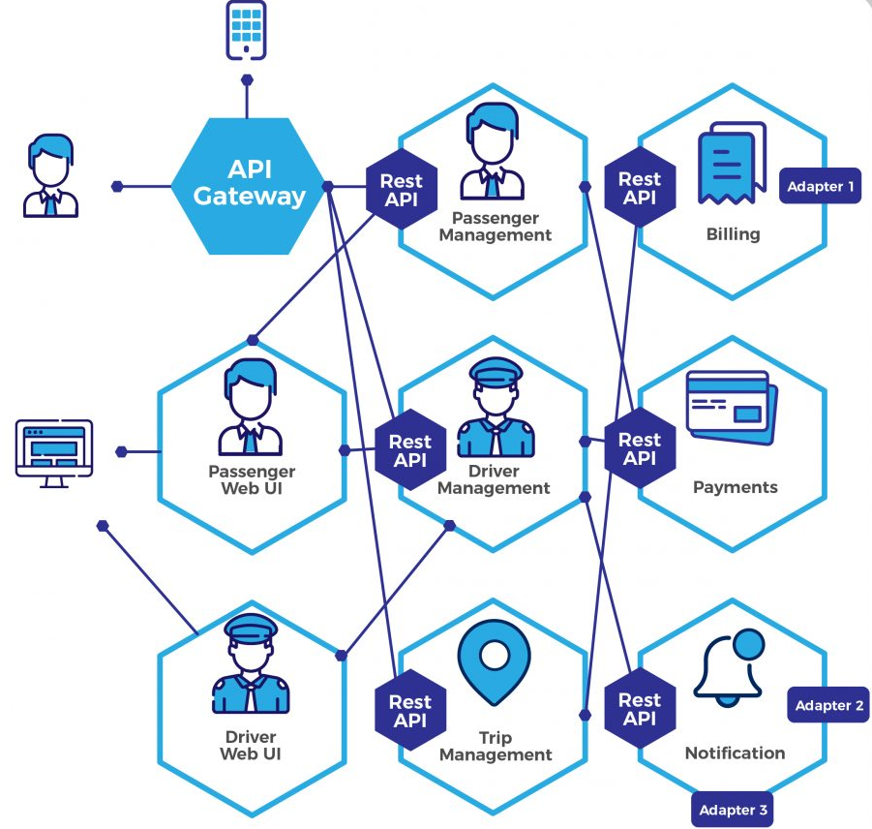
Microservices Architecture
Microservices promote the decomposition of an application into a set of smaller services
Focus on small business capability
Collection of small, loosely coupled, and independently deployable services
Performs single function or closely related functions
Communicate with each other using Rest API
Uses lightweight protocol such as HTTP/HTTPs

Slide 11
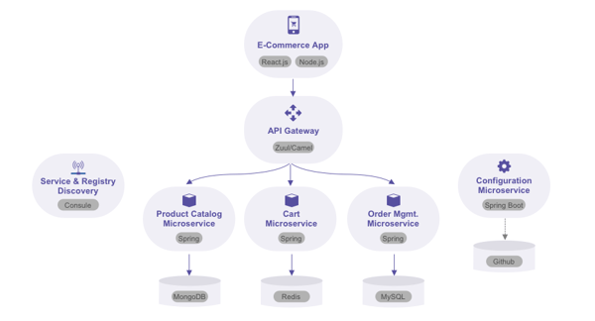

Slide 12
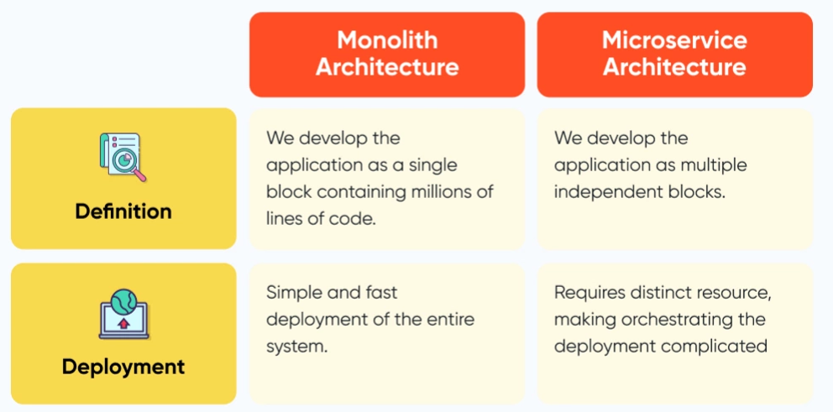

Slide 13
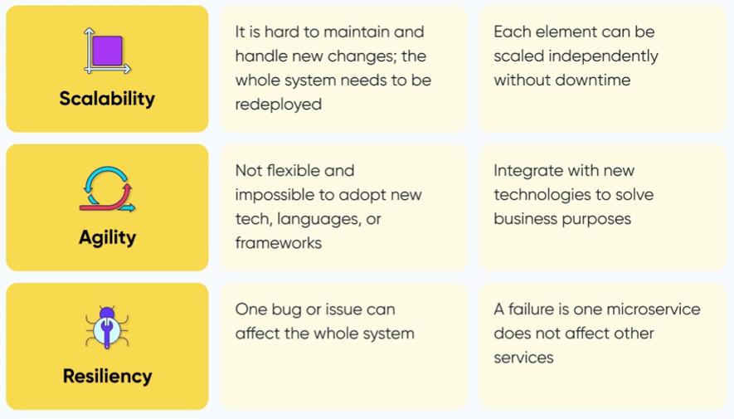

Slide 14
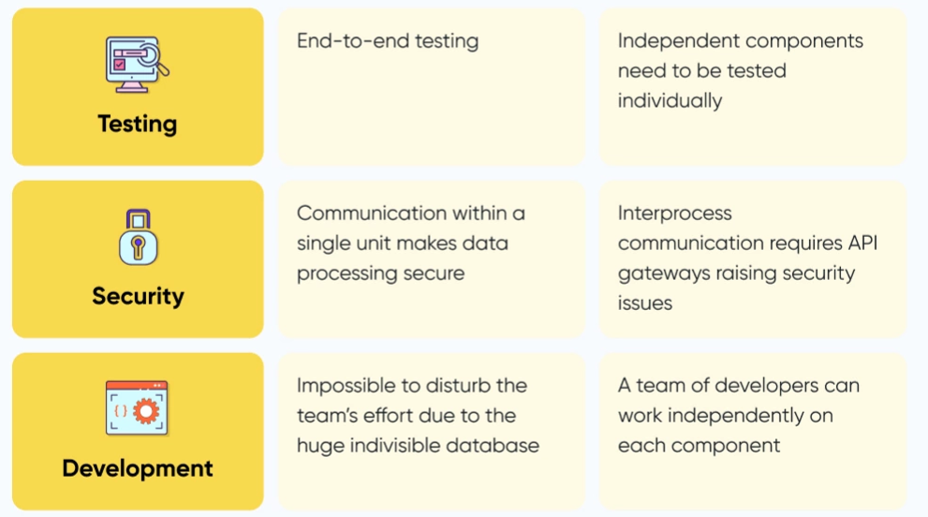

Slide 15
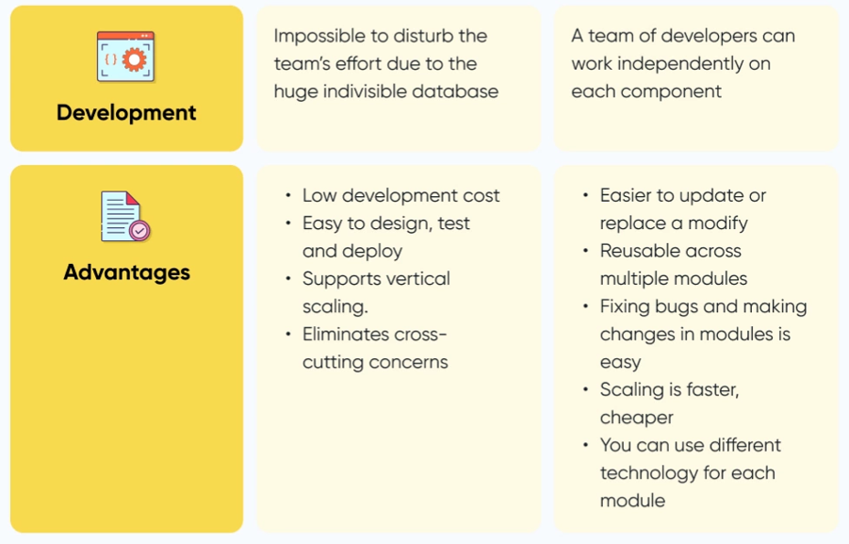

Slide 16
Use Microservices When
Use Monolithic When
The project is large or complex.
Multiple distinct business domains exist within the application.
Scalability, flexibility, and independent deployment are important.
Different teams or individuals can work on separate services.
The ability to adopt new technologies and languages is desired.
The project is relatively small or simple.
There is a single business domain.
Rapid development and deployment are not primary concerns.
Team size and collaboration are limited.

Slide 17
